Slide 1
IT306
Module 4
Big-O : Revisited
LinkedList Data Structure

Slide 2
What is Big O Notation
Measure of performance
Algorithm Optimization
Upper bound for an algorithm
7 Functions
Constant Function : f(n) = c
Logarithm Function: f(n) = logn
Linear Function: f(n)=n
N-log n Function: f(n) = nlogn
Quadratic Function: f(n) = n²
Cube Function: f(n) = n³
Exponential Function: f(n) = a^{n}

Slide 3



Big-O Complexity
Constant : O(1)
Logarithmic: O(log n)
Linear : O(n)
O (n log n)
O(n^2)
O(n^3)
O(2^n)
O(n!)
fastest
increasing speed of execution
slowest
Notes:
Source : http://bigocheatsheet.com/

Slide 4
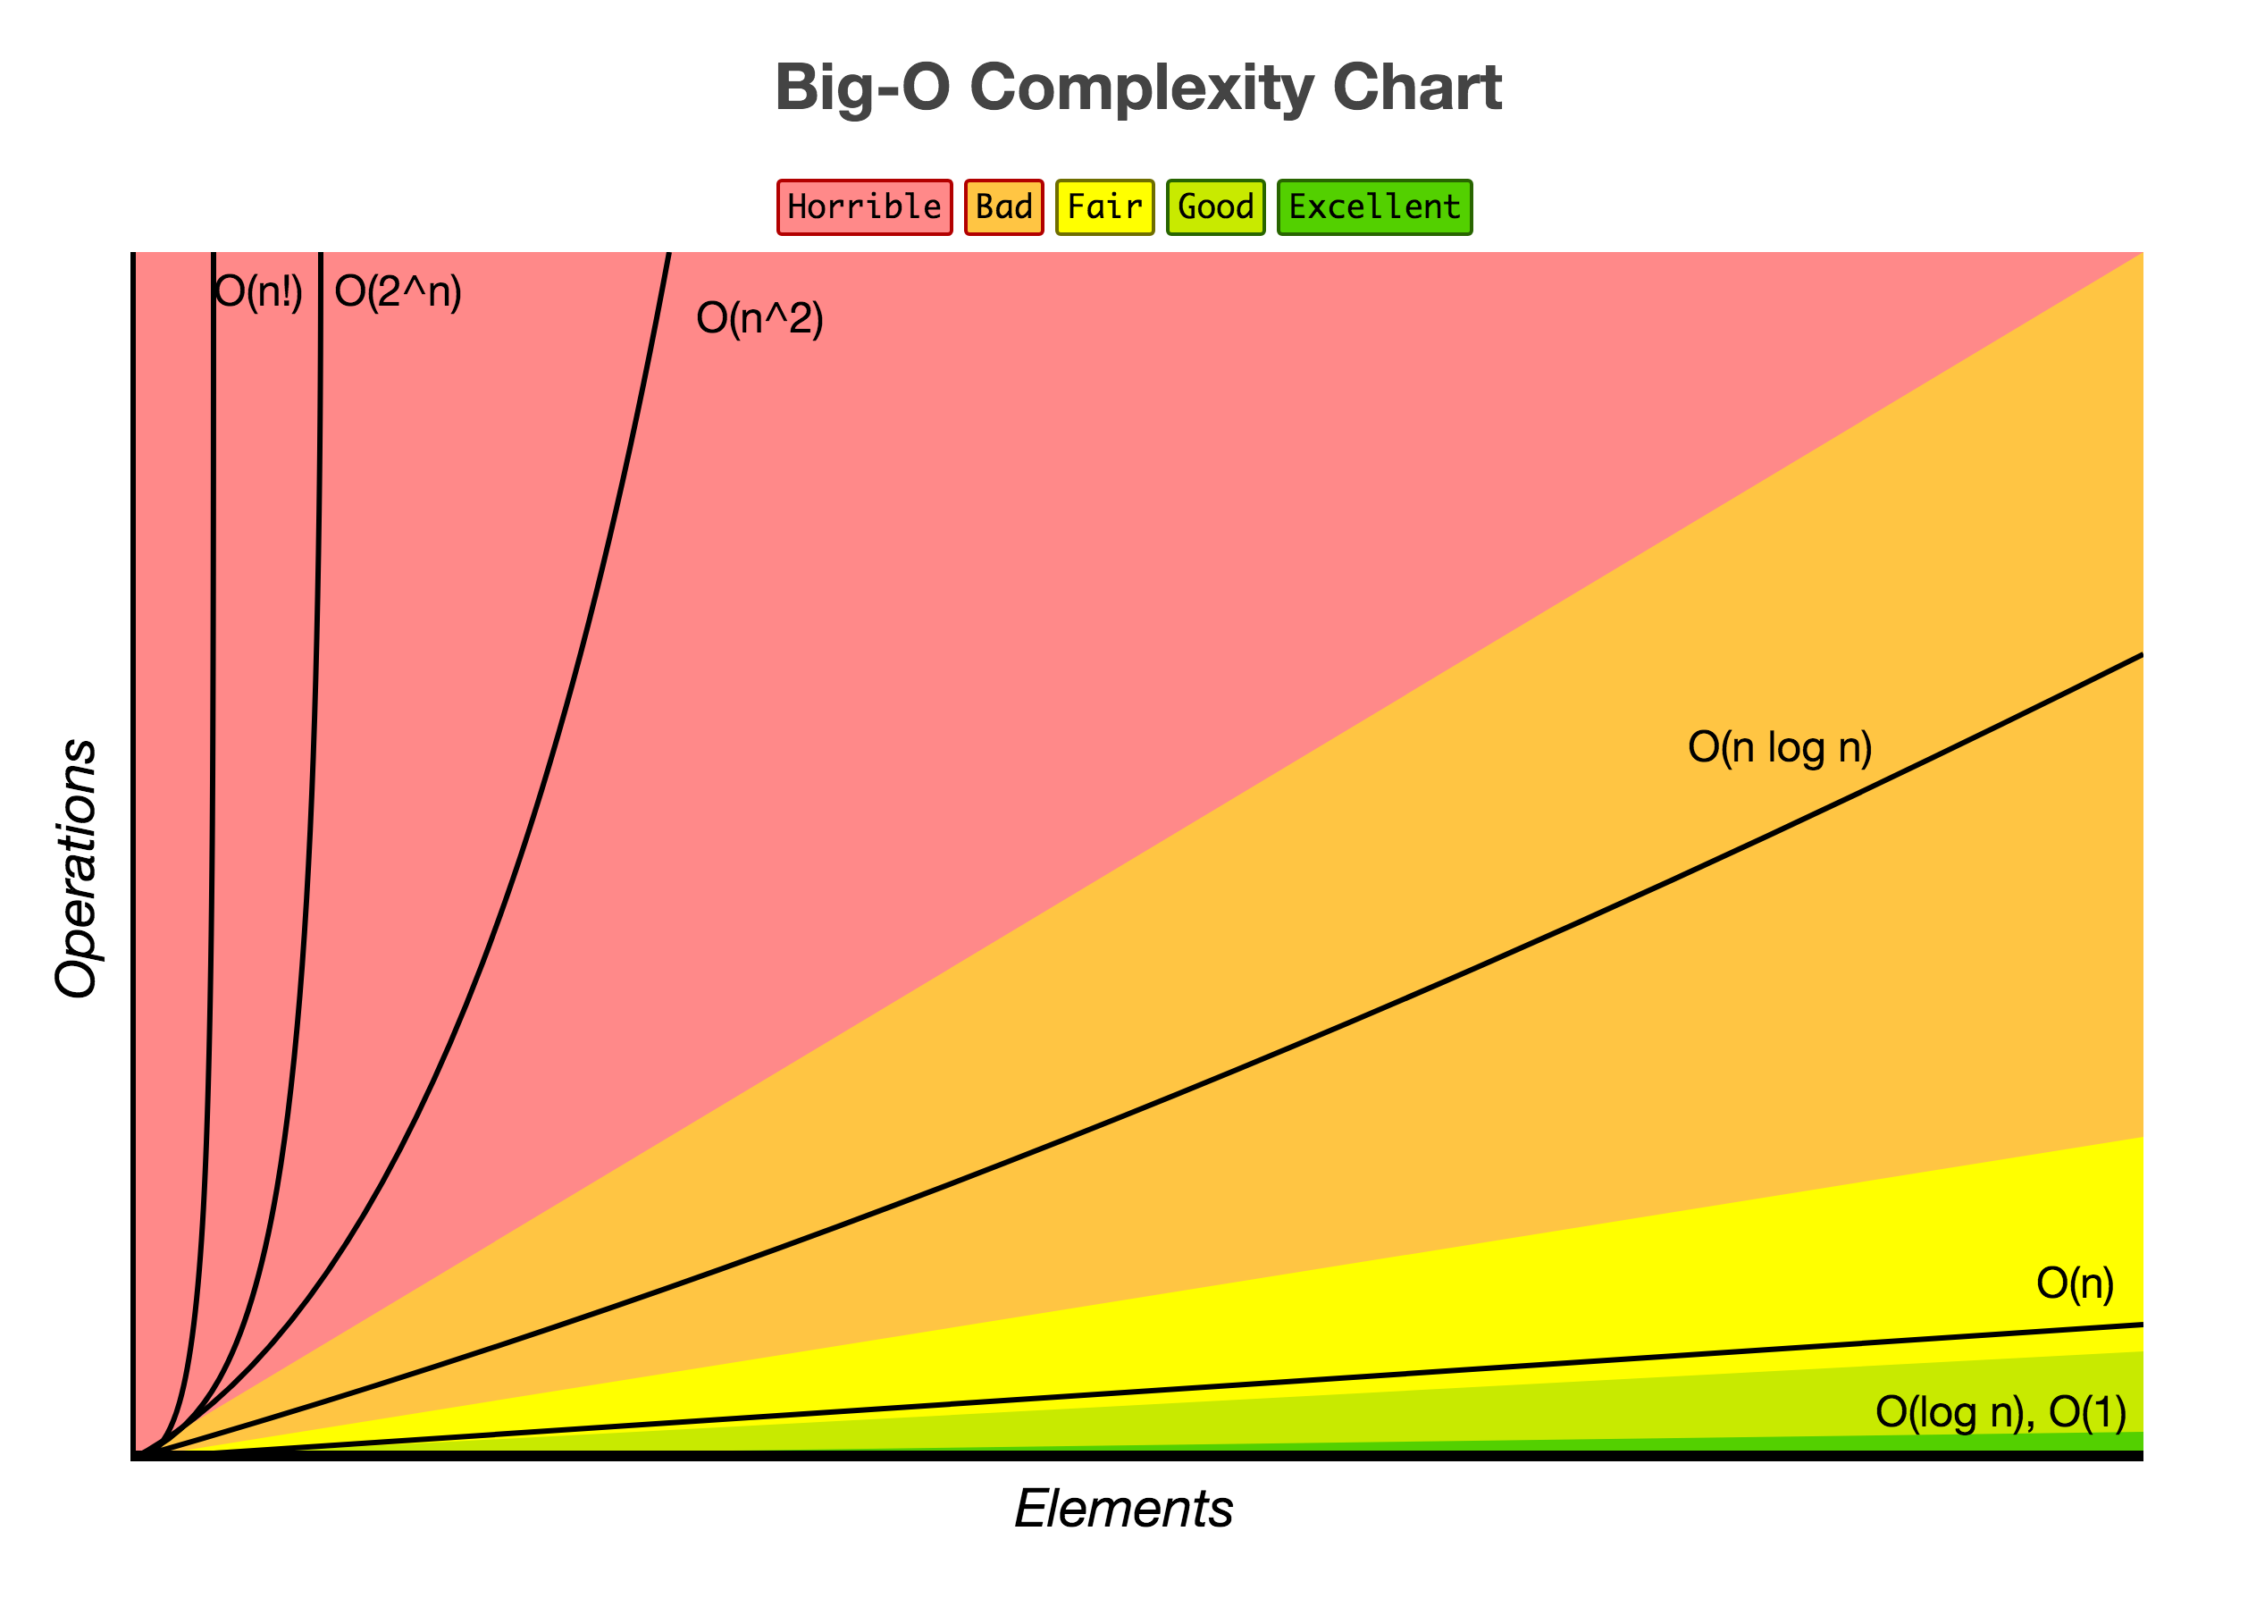
Big-O Complexity
Notes:
Source : http://bigocheatsheet.com/

Slide 5
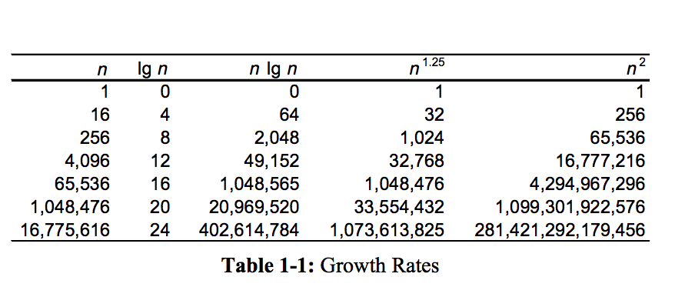
A Comparison

Slide 6
Formal Definition of The Big-O Notation
Let f(n) and t(n) be functions mapping positive integers (n ≥ 1) to positive real numbers.
We say that there is a fixed number that we call the integer threshold n0 ≥ 1 and a positive constant multiplier that we call c > 0, such that: whenever n ≥ n0, then f(n) ≤ cT(n), where f(n) =O(T(n)).
f(n) is a Big O of t(n), or f(n) is the dominant term (highest Order) of t(n)

Slide 7
What is the Big-O complexity of these functions?
f(n) = 5n⁴+ 3n³ +2n² +4n+1
The largest component: 5n⁴
The power can represent the upper bound for the rest
3n³<= 3n⁴; 2n²<= 2n⁴; 4n<= 4n⁴;
f(n) = 5n⁴+ 3n³ +2n² +4n+1 <= 5n⁴+ 3n⁴ +2n⁴ +4n⁴ +1 <= 14n⁴ +1
Discard constants and constant coefs
f(n) <= n⁴ ➔ f(n) <= O(n⁴ )
20n³+10 nlogn + 5
3 logn + 2
2^{n+2}
2n + 100 logn

Slide 8
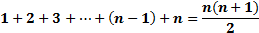
What is the Big-O complexity of these non-recursive algorithms?
1) for (i = 1; i <= n; i++)
k = k + 5;
2) for (i = 1; i <= n; i++)
for (j = 1; j <= n; j++)
k = k + i + j;
3) for (i = 1; i <= n; i++)
for (j = 1; j <= i; j++)
k = k + i + j;
4) for (i = 1; i <= n; i++)
for (j = 1; j <= 20; j++)
k = k + i + j;
→ O(1)
n(n+1) /2←
→ O(1)
n x O(1) = n ; O(n) :linear
½ (n² + n) <= n²→ O(n²)
n x O(1) = n ←
20 x O(1) = 20←
O(1) ←
→ O(1)
n x n = n^2 → O(n²)
n x 20 = 20 n → O(n): linear

Slide 9
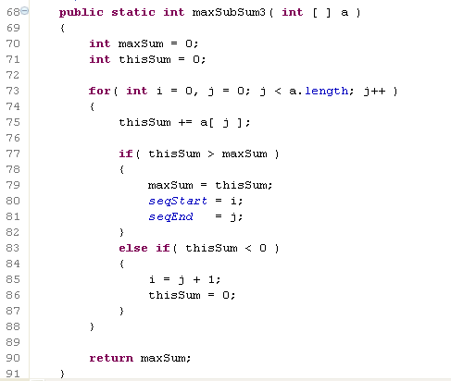
What is the Big-O complexity of this non-recursive algorithm?
→ O(1)
→ O(1)
a.length = n
j changes n times
→ O(1)
n x (1 + 4) +1=5n+1
f(n)<= O(n)
→ O(1)
→ O(1)
4
→ O(1)
→ O(1)
→ O(1)
→ O(1)
3
→ O(1)
→ O(1)

Slide 10
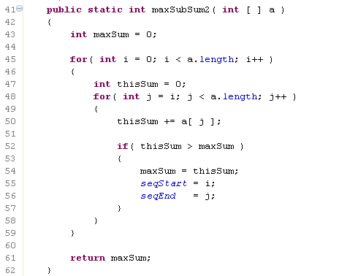
What is the Big-O complexity of this non-recursive algorithm?

Slide 11
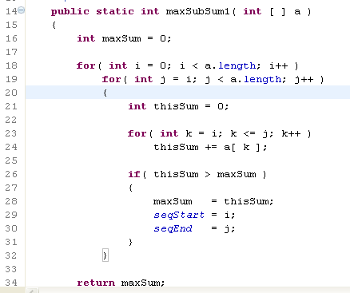
What is the Big-O complexity of this non-recursive algorithm?

Slide 12
Recursive Algorithms
Base Case
Recursive Case

Slide 13
Recursive Merge sort
MergeSort(arr[], l, u) {
If u > l
1. Find the middle point to divide the array into two halves: middle m = (l+u)/2
2. Call mergeSort for first half: Call mergeSort(arr, l, m)
3. Call mergeSort for second half: Call mergeSort(arr, m+1, u)
4. Merge the two halves sorted in step 2 and 3: Call merge(arr, l, m, u)
Merge Sort Algorithm: https://en.wikipedia.org/wiki/Merge_sort

Slide 14
Execution Example
Partition
n
7 2 9 4 ⏐ 3 8 6 1
7 → 7
2 → 2
9 → 9
4 → 4
3 → 3
8 → 8
6 → 6
1 → 1

Slide 15
Execution Example (cont.)
Recursive call, partition
7 2 9 4 ⏐ 3 8 6 1
n/2
n/2
7 2 ⏐ 9 4
n/4
n/4
7 | 2
7 → 7
2 → 2
9 → 9
4 → 4
3 → 3
8 → 8
6 → 6
1 → 1

Slide 16
Execution Example (cont.)
Recursive call, base case
n = 8
7 2 9 4 ⏐ 3 8 6 1
7 2 ⏐ 9 4
7 | 2
n/8 =1
7 → 7
7 → 7
2 → 2
9 → 9
4 → 4
3 → 3
8 → 8
6 → 6
1 → 1

Slide 17
Execution Example (cont.)
Recursive call, base case
7 2 9 4 ⏐ 3 8 6 1
7 2 ⏐ 9 4
7 | 2
n/8 =1
n/8 =1
7 → 7
7 → 7
2 → 2
2 → 2
9 → 9
4 → 4
3 → 3
8 → 8
6 → 6
1 → 1

Slide 18
Execution Example (cont.)
Recursive call,.., base case, Merge
k divide steps, here, k = 4
7 2 9 4 ⏐ 3 8 6 1
7 2 ⏐ 9 4 → 2 4 7 9
7 ⏐ 2 → 2 7
9 4 → 4 9
7 → 7
7 → 7
2 → 2
2 → 2
9 → 9
9 → 9
4 → 4
4 → 4
3 → 3
8 → 8
6 → 6
1 → 1

Slide 19
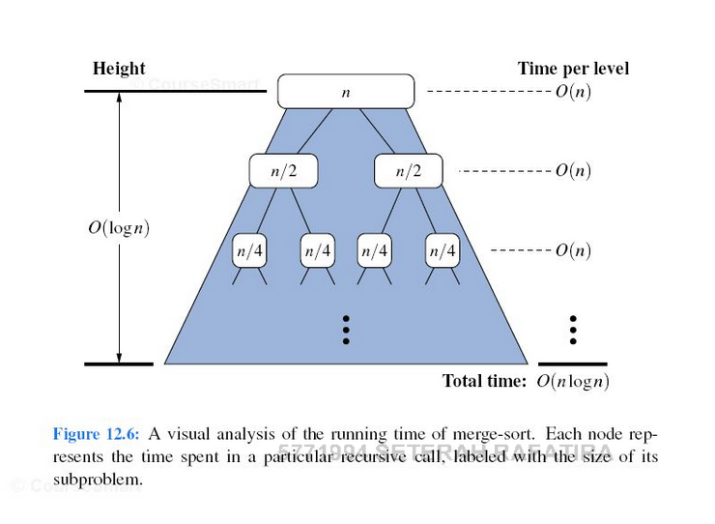
Merge sort
k=
n/2^{k} = 1 : base case
What is k? k = log₂ n

Slide 20
Execution Example (cont.)
Merge
7 2 9 4 ⏐ 3 8 6 1
7 2 ⏐ 9 4 → 2 4 7 9
7 ⏐ 2 → 2 7
9 4 → 4 9
7 → 7
7 → 7
2 → 2
2 → 2
9 → 9
9 → 9
4 → 4
4 → 4
3 → 3
8 → 8
6 → 6
1 → 1
Notes:
Because there are at most n comparisons at each level, the total complexity is nlogn.

Slide 21
Execution Example (cont.)
Merge
7 2 9 4 ⏐ 3 8 6 1
7 2 ⏐ 9 4 → 2 4 7 9
3 8 6 1 → 1 3 6 8
7 ⏐ 2 → 2 7
9 4 → 4 9
3 8 → 3 8
6 1 → 1 6
7 → 7
7 → 7
2 → 2
2 → 2
9 → 9
9 → 9
4 → 4
4 → 4
3 → 3
3 → 3
8 → 8
8 → 8
6 → 6
6 → 6
1 → 1
1 → 1

Slide 22
Execution Example (cont.)
Merge
k levels x n =
log₂n x n = nlog₂n
f(n) = O(nlog₂n )
7 2 9 4 ⏐ 3 8 6 1 → 1 2 3 4 6 7 8 9
7 2 ⏐ 9 4 → 2 4 7 9
3 8 6 1 → 1 3 6 8
7 ⏐ 2 → 2 7
9 4 → 4 9
3 8 → 3 8
6 1 → 1 6
7 → 7
7 → 7
2 → 2
2 → 2
9 → 9
9 → 9
4 → 4
4 → 4
3 → 3
3 → 3
8 → 8
8 → 8
6 → 6
6 → 6
1 → 1
1 → 1

Slide 23
Calculating the Time Complexity of Binary Recursive Merge Sort
T(n) = 2 x T(n/2) + n
= 2² x T(n/2²) + 2n
= 2³ x T(n/2³) + 3n
= 2⁴ x T(n/2⁴) + 4n
= 2⁵ x T(n/2⁵) + 5n
…
= 2^{k} T(n/2^{k} ) + kn ; T(1) = 1
n/2^{k} = 1 ➔ k = log₂n
T(n) = 2^{k} T(n/2^{k} ) + kn = 2^{log2n} x T(1) + n log₂n = n + 1 + n log₂n <= 2x n log₂n
hence, f(n) <= c.T(n); T(n) = O(nlog₂n)
T(n/2) = 2 x T(n/2²)
T(n/2²) = 2 x T(n/2⁴)

Slide 24
Quick sort
Divide and conquer (Recursively). Recursion will be discussed later.
Choose a pivot value. We take the value of the middle element as pivot value, but it can be any value, which is in range of sorted values, even if it doesn't present in the array.
Partition. Rearrange elements in such a way, that all elements which are lesser than the pivot go to the left part of the array and all elements greater than the pivot, go to the right part of the array. Values equal to the pivot can stay in any part of the array. Notice, that array may be divided in non-equal parts.
Sort both parts. Apply quicksort algorithm recursively to the left and the right parts.

Slide 25
Quick sort: Divide phase
Sort this array using Quick sort: { 1, 12, 5, 26, 7,14, 3,7, 2}
Pivot’s index = (LB + UB)/2
Pivot selection
Middle element
Randomized pivot, e.g., median of three values of front, middle, tail.
For larger datasets, the median of more than three potential pivots might be computed.
1,12,5,26,7,14,3,7,2
Pivot = 7
1,5,3,2
Pivot = 5
7,12,26,14,7
Pivot = 26
1,3,2
5
7,12,14,7
Pivot = 12
26
Pivot = 1
1,2
3
7,7
12,14
Notes:
Median: the median is the numerical value separating the higher half of a data sample from the lower half.
The middle number or the mean of the middle two numbers.

Slide 26
Quick sort: Merge phase
Sort this array using Quick sort: { 1, 12, 5, 26, 7,14, 3,7, 2}
Pivot’s index = (LB + UB)/2
k = [log n , n]
1,12,5,26,7,14,3,7,2→1,2,3,5,7,7,12,14,26
1,5,3,2 → 1,2,3,5
7,12,26,14,7→ 7,7,12,14, 26
1,3,2→ 1,2,3
5
7,12,14,7→ 7,7,12,14
26
1,2
3
7,7
12,14
Merge
Balanced partitions: O(nlog₂n)
Unbalanced partitions : ((n²)
https://www.khanacademy.org/computing/computer-science/algorithms/quick-sort/a/analysis-of-quicksort
Notes:
Median: the median is the numerical value separating the higher half of a data sample from the lower half.
The middle number or the mean of the middle two numbers.

Slide 27
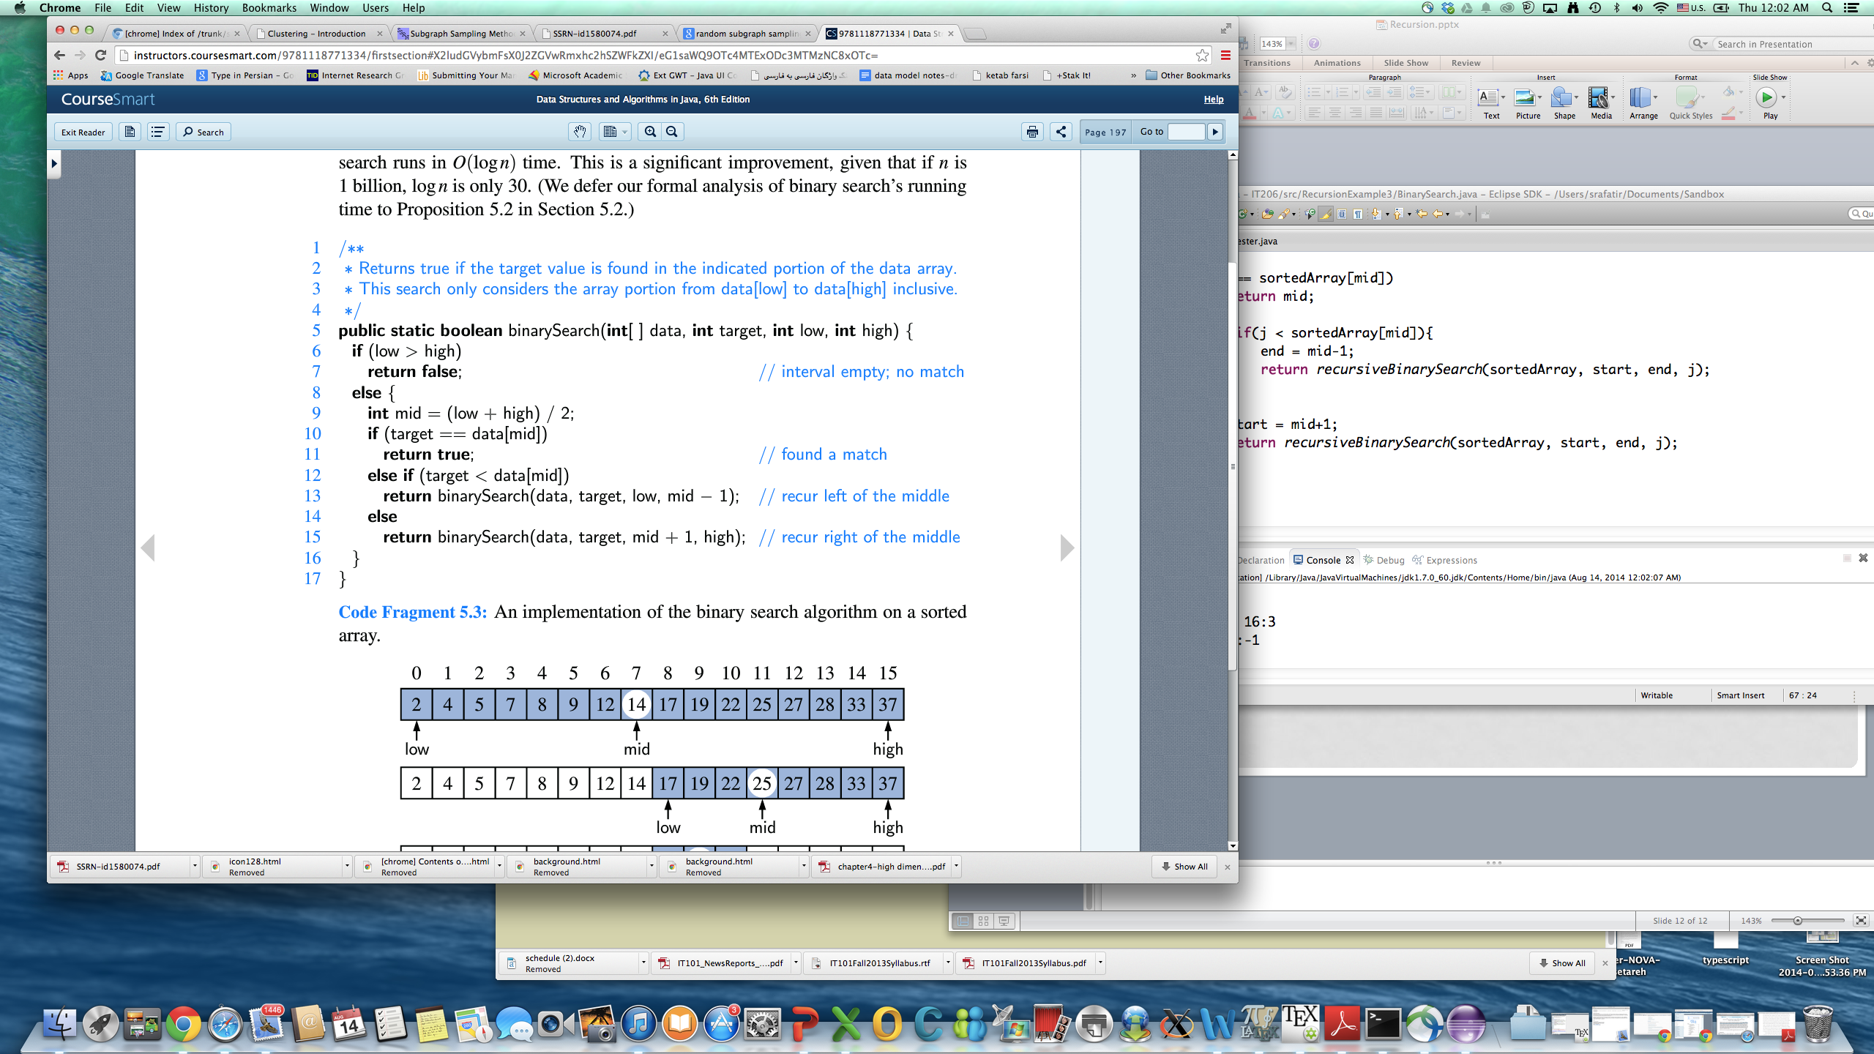
Recursive Binary Search cont.
Recursive Implementation:
Illegal condition (low > high)
Base case (data[mid] == target)
Recursive case (target<data[mid] OR target>data[mid])
T(n/2) = T(n/2²)+c
T(n) = T(n/2)+c
= T(n/2²)+2c
= T(n/2⁴)+3c
= T(n/2⁸)+4c
= T(n/2⁶)+5c
…
= T(1)+kc =T(n/2^{k})+kc
T(1) = 1 ; n/2^{k} = 1 ➔ k = log₂n
f(n) <= T(n); T(n) = O(log₂n)

Slide 28
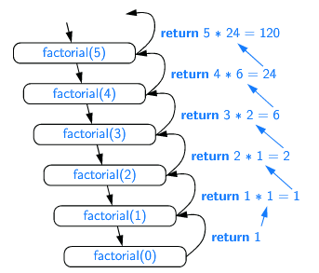
Time Complexity of Factorial Function
f(factorial(n)) = O(n)
T(n) = T(n-1) +c
= T(n-2) +2c
= T(n-3)+3c
…
= T(n-(k-1)) + (k-1)xc
= T(0) + c.k = c. n
T(0) = 1 ➔k=n ➔ f(n) <= c.T(n) ; T(n) = O(n)
T(n-1) = T(n-2) +c
T(n-2) = T(n-3)+c

Slide 29
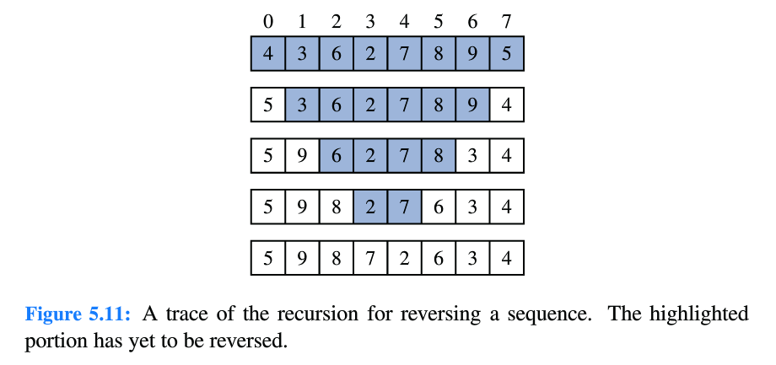
More Examples cont.
Reversing a sequence → 5,4,3,2,1
T(n) = 3 + T(n-2)
= 2x3 + T(n-4)
= 3x3 + T(n-6)
…
= kx3 + T(n-k) = 3.n
T(1) = 1 ; if n is odd
T(0)=1; if n is even;
k=n; f(n)<=c.T(n); T(n) =O(n)
int[] reverse(int[] data, int low, int high){
if(low>high) return data;
swap(data[low],data[high]);
return reverse(data, ++low,--high);
}

Slide 30
More Examples cont.
Suppose f is a method that converts a decimal into binary representation as a sequence of binary characters (or a string). The recursive method is shown below:
f(n) : n>= 2 ; return append(f(n/2), n%2 )
n<2; return n
T(n)= T(n/2) + c
= T(n/2²) + 2c
= T(n/2³) + 3c
= T(n/2⁴) + 4c
…
= T(n/2^{k-1}) + c.(k-1)
= T(n/2^{k}) + c.k ; T(1) = 1 ; k = log₂n ➔ f(n) <= c.T(n) ; T(n) = c. log₂n
Time Complexity = O(log₂n )

Slide 31
LinkedList

Slide 32
What is a linked list?
Chain of linked nodes
Flexibility and extensibility in size (dynamic size)
Linear data structure
Each node is a separate object
Ease of insertion and deletion
No support for random access
Extra memory pointer required for each element of the list

Slide 33
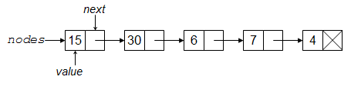
What is a linked list?
tail
tail
: null
head
head
head
data
reference
data
null
data
public class Node{
private int data;
private Node next;
public Node(int d,Node n){
data=d; next=n; }
public Node getNext(){
return next;}
public int getData(){
return data; }
public addNodeAfter(Node n){
//TODO }
….
}
reference
.
.
.
tail
data
reference
Notes:
Compare with arrays in terms of index, size, extensibility.
Null reference is used for the link part of the final node.

Slide 34
Node Data Definition Class
public class Node{
private int data;
private Node next;
private static int total;
public Node(int d,Node n){
data=d; next=n;
total++;
}
public Node getNext(){ return next; }
public int getData(){return data; }
}
public class Node{
private Student data;
private Node next;
private static int total;
public Node(Student d,Node n){
data=d; next=n;
total++;
}
public Node getNext(){ return next; }
public Student getData(){return data; }
}
Notes:
Increment a counter outside of the Node class each time a new node is initialized, or adding a static field to preserve the length of the linkedlist.

Slide 35
Exercise1
Part-a: Given the class “Node”, create a instance method that stores input data in a linked list one at a time.
head
tail
data1
data2
…
data n
Procedure Add to the end of a list:
Read data from input
Create a new node and fill its data component, then make that a null reference.
Link that to the tail node in the list.
Update tail.
Part-b: What if we want to add to the beginning of the list?
(Your turn now)
new node
head
tail
data1
data2
…
data n

Slide 36
Example
Maintain a list of ”scientist” objects in a linkedlist structure.
public class Scientist implements Comparable<Scientist>{
private String name;
public Scientist(){}
public Scientist(String name) {this.name = name; }
public String getName() {return name; }
public String toString() {return name; }
public int compareTo(Scientist o) {
if(this.name.compareToIgnoreCase(o.getName())<0) return -1;
else if (this.name.compareToIgnoreCase(o.getName())> 0) return 1;
else return 0;
}
}

Slide 37
Example cont.
public class TNode {
private Scientist data;
private TNode next; //link
public TNode(Scientist data, TNode next){
this.data = data;
this.next = next;
}
public void setData(Scientist data) { this.data = data; }
public void setNext(TNode next){ this.next = next; }
public Scientist getData(){return data; }
public TNode getNext() { return next; }
public boolean hasNext() {
if (next!=null) return true;
else return false;
}
}

Slide 38
Example cont.
public class TLinkedList {
private TNode head;
private int size;
public TLinkedList(){size = 0;}
public boolean isEmpty() {
if (head==null)
return true;
else return false;
}
public int getSize() { return size; }
.
.
.

Slide 39
Example cont. : TLinkedList class
public void add(TNode node){//add to the end of the linkedlist
size++;
if(head==null) head = node; //if the linkedlist is empty
else{
TNode curr = head;
if(!curr.hasNext()) {//if linklist has only one node
curr.setNext(node);
}
else{//if there are multiple nodes
while(curr.hasNext()){
curr = curr.getNext();
}
//curr indicates the end of the linkedlist structure now
curr.setNext(node); //add to the end of the linkedlist
}}}

Slide 40
Example
Use the linked list to remove a node from the head of the list.
data1
data2
…
data n
head
tail
Procedure:
Store the reference to the next node after head in “newHead”
Change the reference of head node to null reference
Update head with “newHead”
data1
data2
…
data n
head
newHead
tail
null
data2
…
data n
Head =
newHead
tail

Slide 41
Example cont. : TLinkedList class
public Scientist remove(){ //return and remove from the head of the linkedlist
if(isEmpty()) return null;
TNode oldHead= head;
if(!curr.hasNext()) {//size ==1
Scientist data = head.getData();
head= null;
return data;
}
//two or more elements in the linkedlist
Scientist data = head.getData();
oldHead= head;
head = head.getNext();
oldHead.setNext(null);
oldHead= null;
return data;
}

Slide 42
Example
Use the linked list to remove a node from the tail of the list.
data1
data2
…
data n
head
tail

Slide 43
Example cont. : TLinkedList class
public Scientist remove(){ //return and remove the last element of the linkedlist
if(isEmpty()) return null;
TNode curr = head;
TNode previous = head;
if(!curr.hasNext()) {//size ==1
Scientist data = curr.getData();
head= null;
return data;
}
else{ //multiple elements inside the linkedlist
while(curr.hasNext()){
previous = curr;
curr = curr.getNext();
}
Scientist data = curr.getData();
previous.setNext(null);
curr = null;
return data;
}}
(Your turn now)

Slide 44
Other Related Problems
Add a static method to return a reference to the node at the specified node position in the list. The first node is position 1, the next node is position 2, and so on.
Use the linked list in exercise2-part-a to perform linear search. If the query is found, return the matched node. (static method)
Use the linked list in exercise2-part-a to perform linear search. If the query is found, delete the matched node from the list.
Use the linked list in exercise2-part-a to perform linear search. If the query is found, add a new node to the list after the matching point, with data 1500.
Use the linked list in exercise2-part-a to perform linear search. If the query is found, add a new node to the list before the matching point, with data 1500.
Make a copy of a list, and return the head for the newly created copy.
Make a copy of a list, and return the head and the tail for the newly created copy.

Slide 45
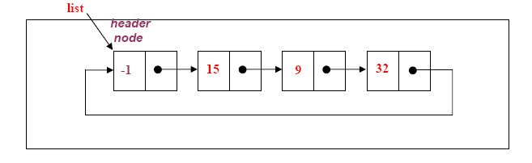
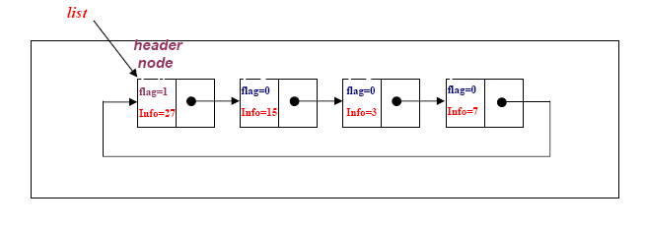
Circular linked lists
A circular list is very similar to the linear list where in the circular list the pointer of the last node points not NULL but the first node.
head
current
head
data1
data2
….
datan
data1
….
Head node:
Sentinel node
flag

Slide 46
Doubly linked lists
head
current
tail
data1
data2
….
datan

Slide 47
Doubly linked lists- Insert
newNode
datah
head
current
tail
data1
data2
….
datan
newNode
datah
head
current
tail
data1
data2
….
datan

Slide 48
Doubly linked lists- Delete
head
cursor
current.getNext()
tail
data1
datah
data2
….
datan
head
cursor.getNext()
tail
data1
data2
….
datan
cursor
datah
cursor.getPrevious.setNext(cursor.getNext());

